Slide 1
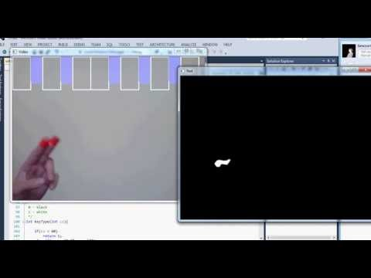
IMAGE PROCESSING BASED VIRTUAL INSTRUMENT
project mentor
Dr. M. Gangadharappa
SUBMITTED BY :
AISHWARYA PANDEY-12210102812
LOKENDER SARNA-17010102812
Subhit Kumar Chatterji - 17110102812

Slide 2
INTRODUCTION
Allows user to access virtual instrument at the go , any time , anywhere.
Virtual Instrument allows user to play a musical instrument using human computer interaction.
Here, we have implemented a virtual piano based on image processing.
Image processing in this project has been implemented using MATLAB .
Piano tunes have been implemented using sinusoidal functions.

Slide 3
Tools and Resources
MATLAB Image processing toolbox
MATLAB Image acquisition toolbox
USB Camera
Laptop
Red coloured Tape(For detection of key pressed)
Enthuthiastic user

Slide 4
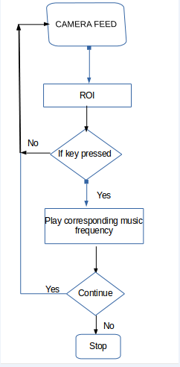
BLOCK
DIAGRAM

Slide 5
Control Flow
Dividing Region of Interest
The width of camera field of view is divided into seven equal parts.
These seven different parts serve as seven different keys.
Colour Detection
First the centroid of red colour is detected.
Then it is matched with corresponding region of interest .

Slide 6
Control Flow continued…
How red colour is detected
Extract red component from the frame.
Obtain the gray scale component of the frame.
Subtract the red component from the gray scale component.
On subtraction we obtain the point with red colour.
Next we find centroid of red colour and then find out the corresponding key.

Slide 7
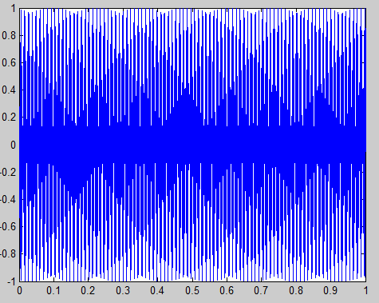
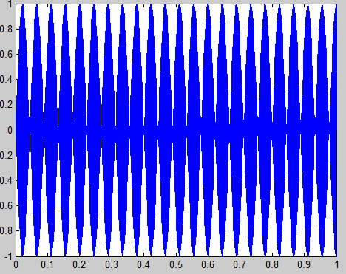
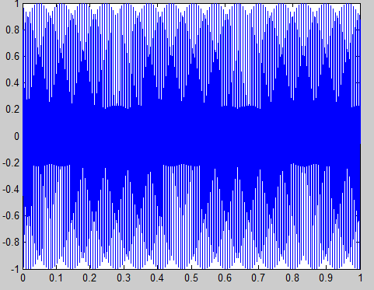
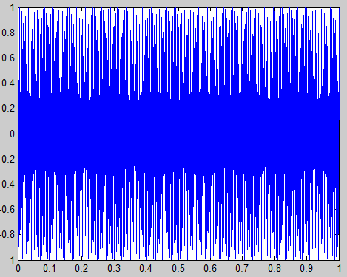
SIMULATION OF SOUND WAVES
SA
RE
GA
MA

Slide 8
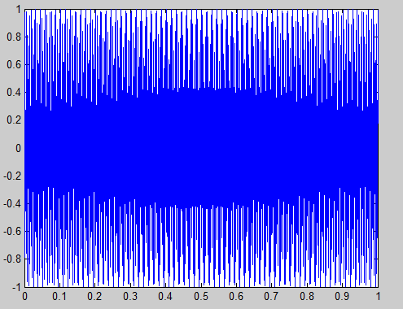
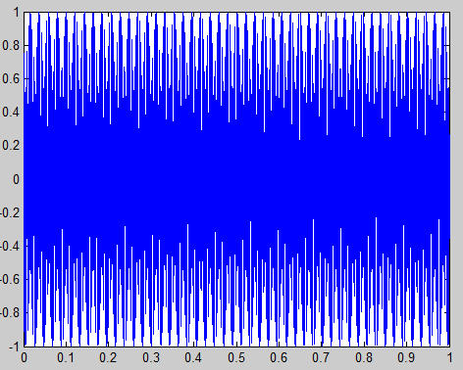
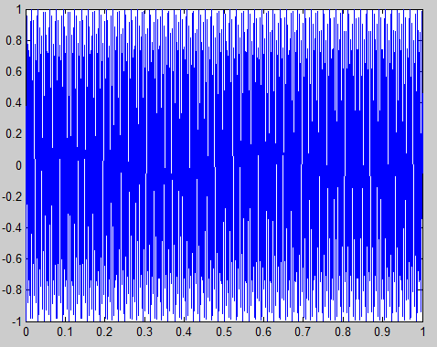
SIMULATION (CONTD.)
PA
DHA
NI

Slide 9
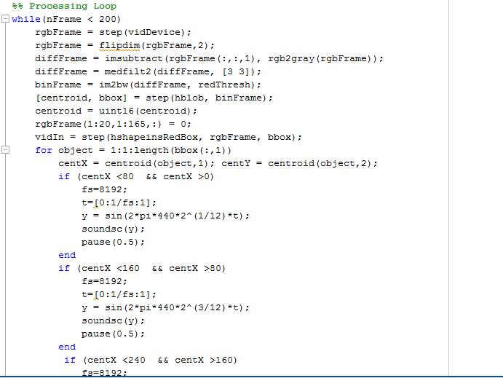
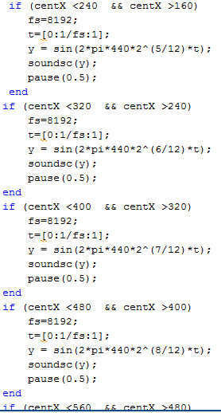
SOURCE CODE

Slide 10
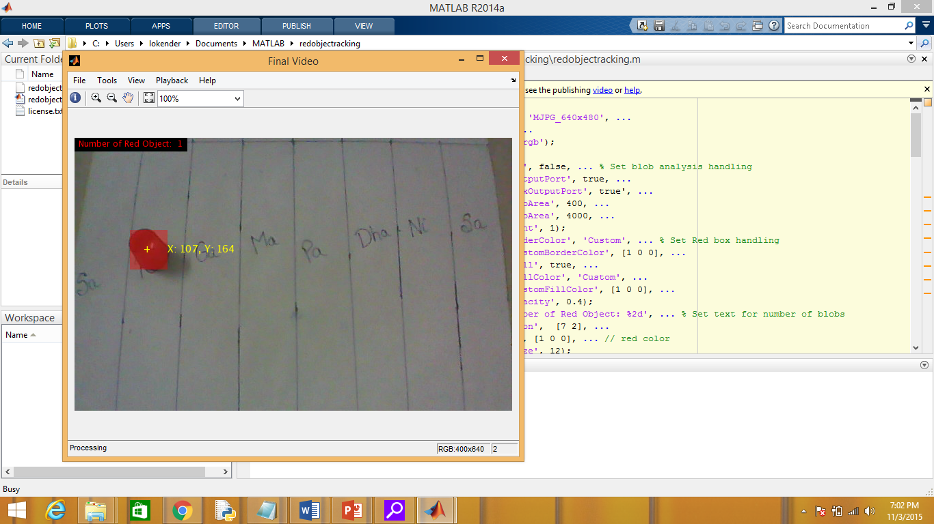
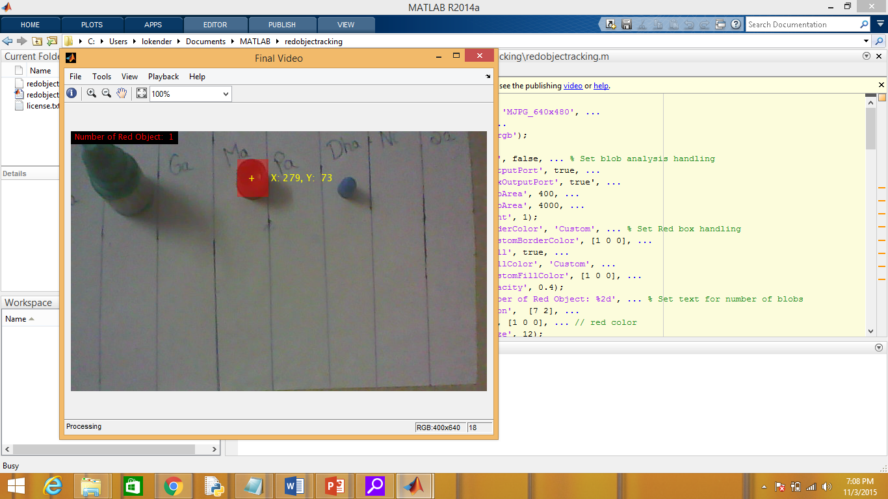
ACTUAL WORKING
RED OBJECT IS PRESENT
RED GREEN AND BLUE OBJECTS ARE PRESENT

Slide 11
Application and Future Scope
This concept can be implemented in
Object Detection
Gesture Detection
Virtual Keyboards
Human – Computer Interaction
Virtual Instruments can be extended to guitars, drums and many other musical instruments.
The future era belongs to Sixth Sense Technology which has recently been seen in Samsung devices.

Slide 12
REFRENCES
Mu-Hsen Hsu, Timothy K. Shih , Jen-Shiun Chiang ; Real-Time Finger Tracking for Virtual Instruments , 2014 7th International Conference on Ubi-Media Computing and Workshops
David Olivieri, Iván Gómez Conde, Xosé Antón Vila-Sobrino ; AR-based Virtual Musical Instruments using SMC Tracking , IEEE XPLORE 2012
Mäki-Patola, T., Kanerva, A., Laitinen, J., Takala, T., "Experiments with Virtual Reality Instruments", Proc. Int. Conf on New Interfaces for Musical Expression (NIME'05), 2005
J. Carmigniani, B. Furht, M. Anisetti, P. Ceravolo, E. Damiani, and M. Ivkovic, Augmented reality technologies, systems and applications, Multimedia Tools and Applications, 2011, 51(1), pp 341-377

Slide 13


THANK YOU

